Slide 1
32b – Clean Code – NullObject, Proxy and Decorator Patterns
Based on the CleanCoders videos by Uncle Bob Martin
Rupert Waldron

Slide 2
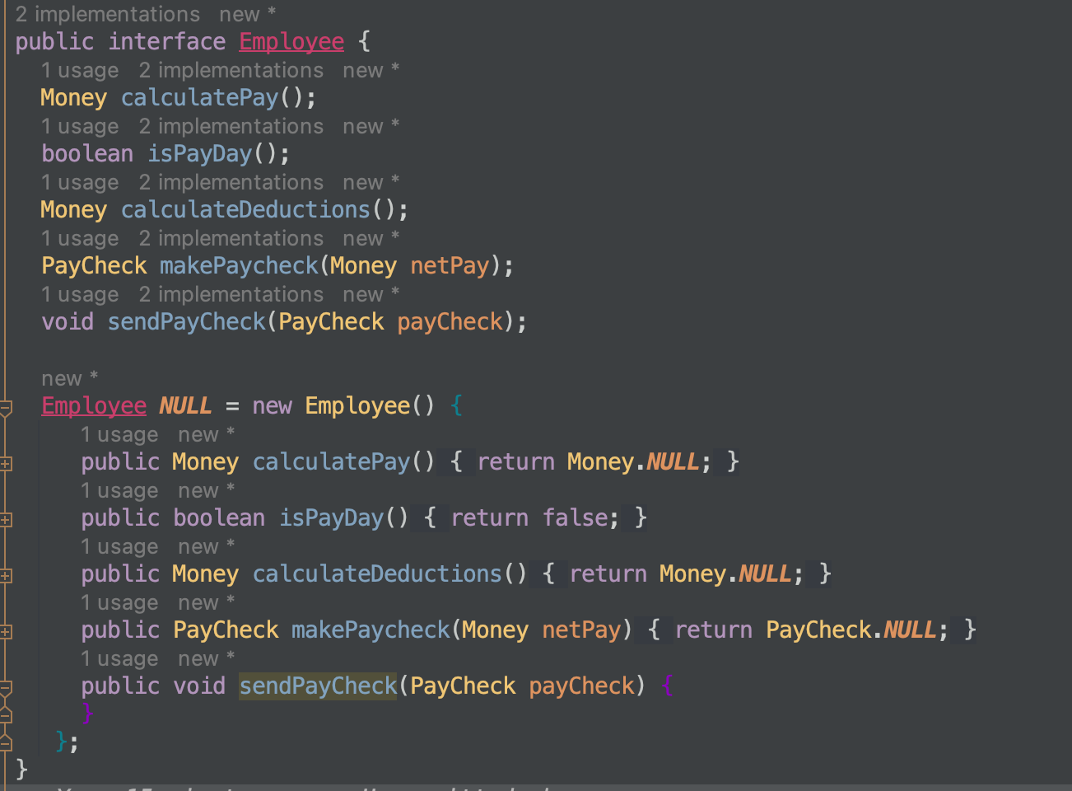
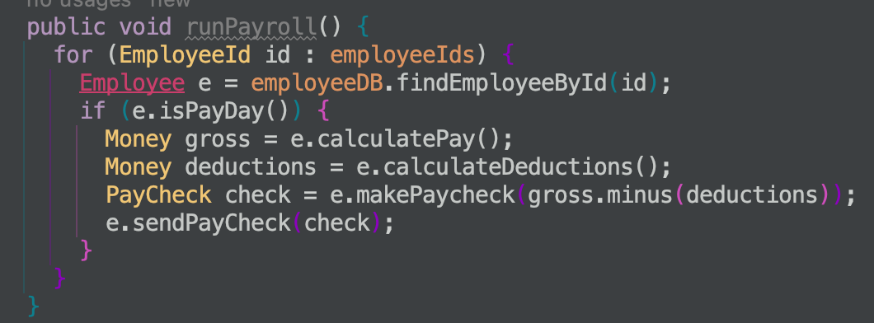
NullObject Pattern
When you don’t want to return null if something doesn’t exist. Normally you would have to check for null – or forget and get a nullpointer exception.
This nullObject implements all the methods of the normal object – but typically they do nothing.
This nullObject implementation ensures that it will slip through the system with no consequences – isPayDay() returns false

Slide 3
Proxy Pattern
The Proxy Pattern provides a surrogate or placeholder for another object to control access to it
The proxy object wraps the real by containing an instance of it and implementing the same interface
Real Object
Data in
Proxy Object

Slide 4
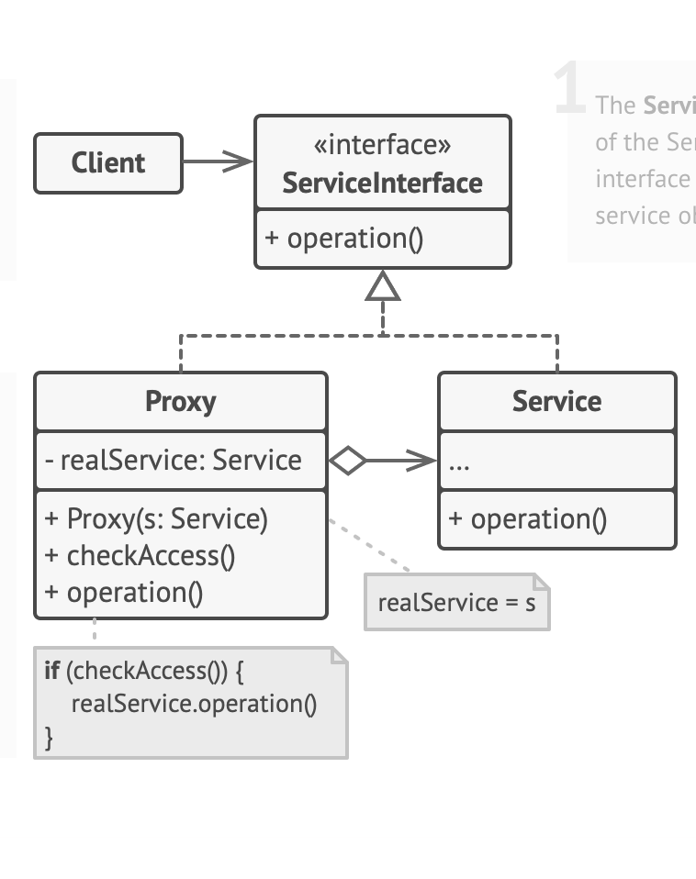
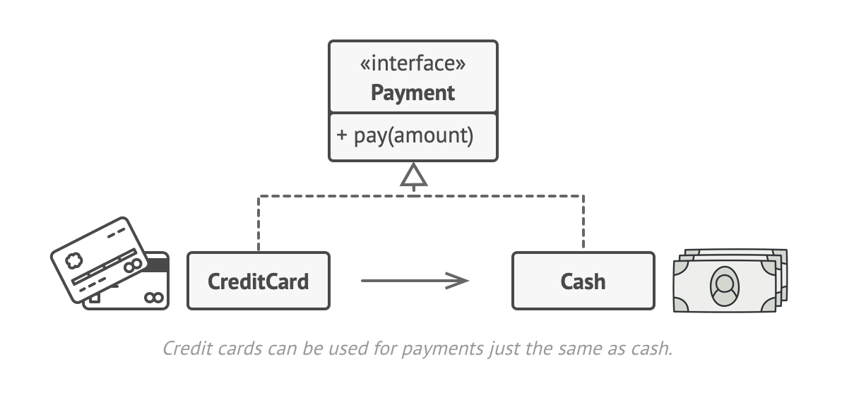
Proxy Pattern
The Proxy Pattern provides a surrogate or placeholder for another object to control access to it
Real world analogy
Look at the code for another example

Slide 5
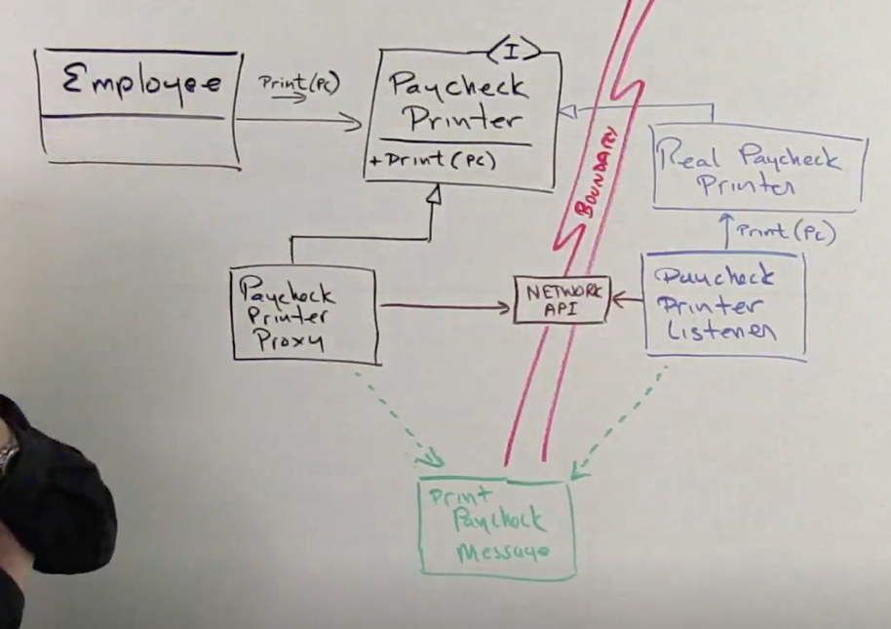
Proxy Pattern
The Proxy Pattern enables communication over a network invisible to the client
The Employee wants to print(pc). The real paycheck printer is over a network somewhere else.
The Paycheck Printer Proxy implements Paycheck Printer Interface and print(pc) is called upon it.
The proxy then constructs a print paycheck message to send over the next work to the paycheck listener (e.g. controller) which then calls the real paycheck printer.

Slide 6
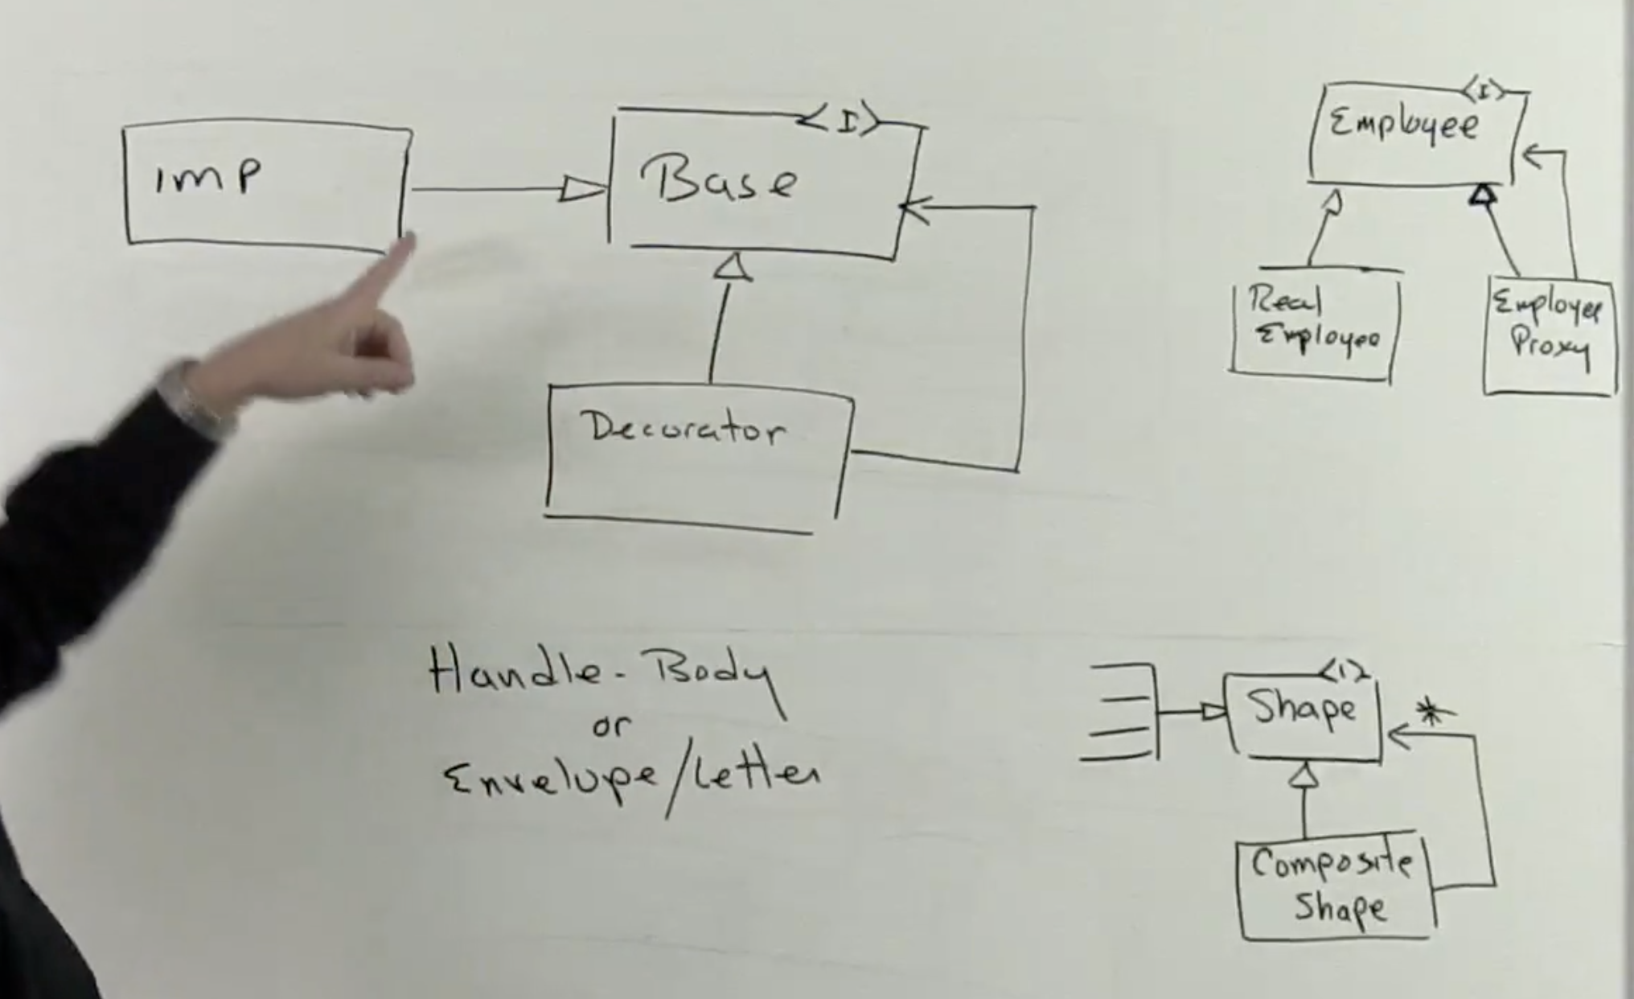
Decorator Pattern
The Proxy Pattern is one of the Decorator type of patterns
Use the Decorator Pattern to attach additional responsibilities to an object dynamically.
Decorators provide a flexible alternative to subclassing for extending functionality - Gof
The Decorator holds an implementation/Decorator usual adding functionality as it goes.
The Decorators are normally chained together.
The Decorator is another approach, other than the Visitor pattern to add behaviour to an existing hierarchy without changing that hierarchy

Slide 7
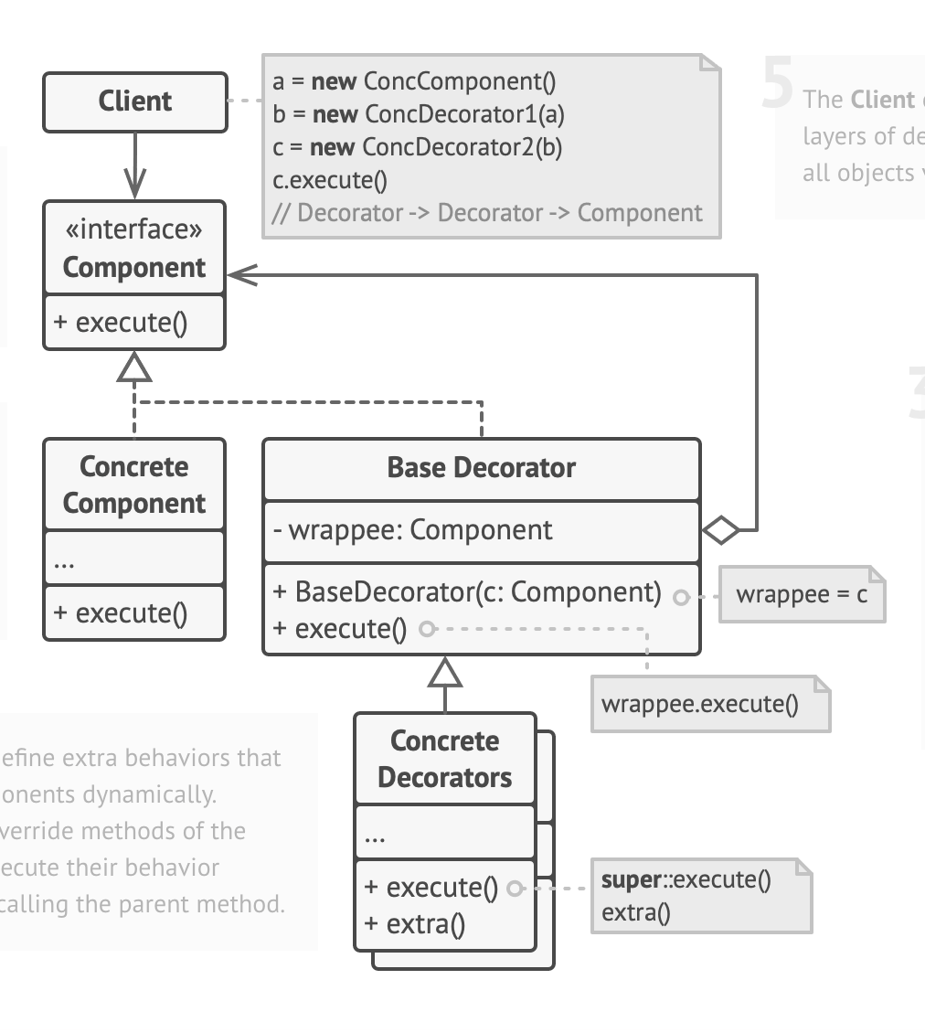
Decorator Pattern
The Decorator holds an implementation/Decorator usual adding functionality as it goes.
The Decorators are normally chained together.

Slide 8
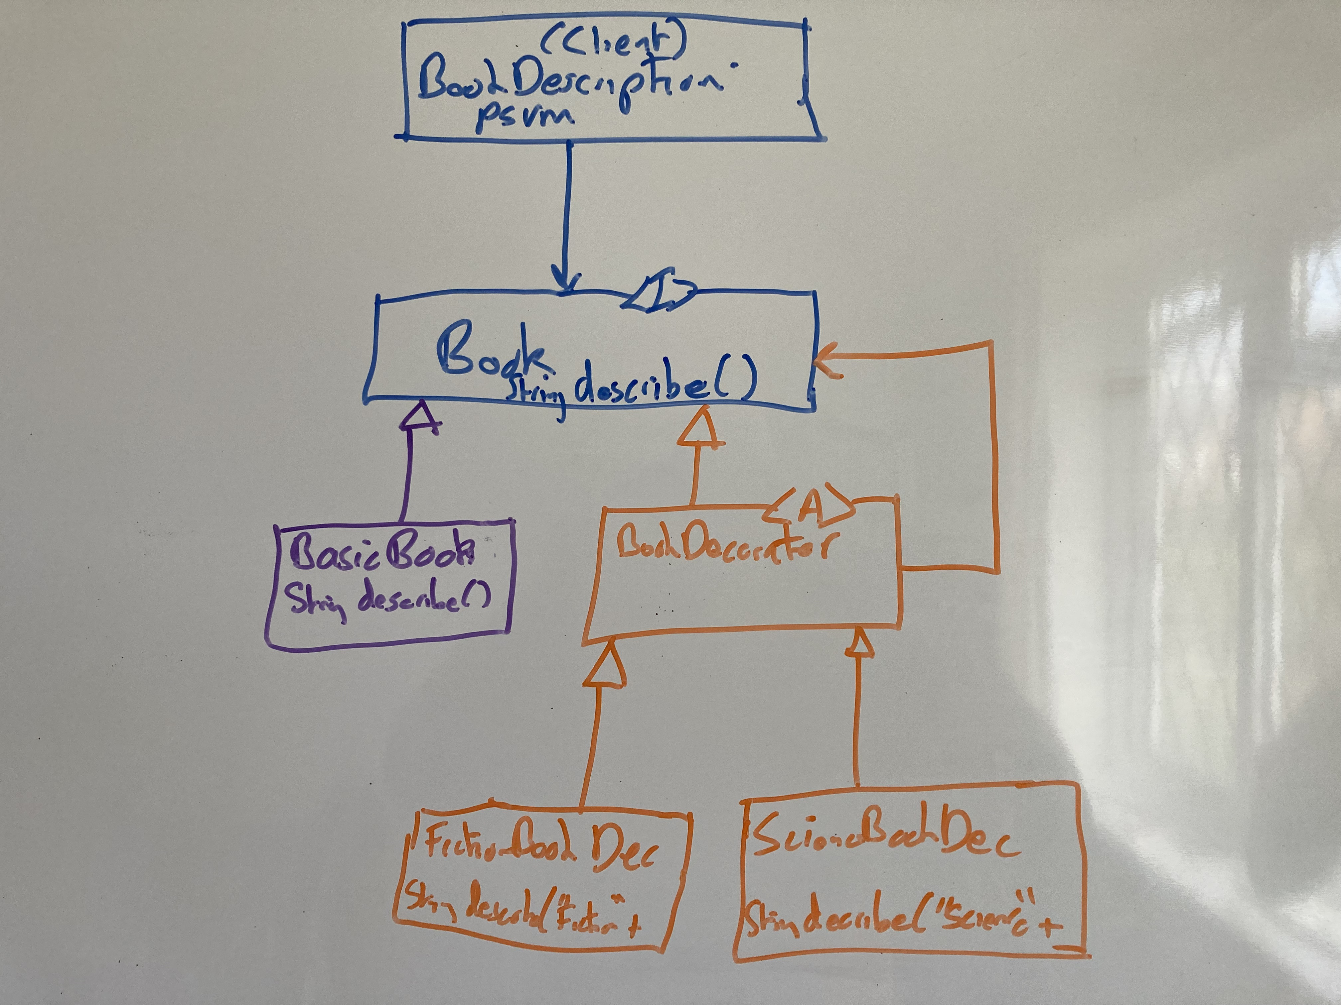
Decorator Pattern – Book Example
The BookDecorator holds an instance of Book but also implments the Book interface – typical structure of the pattern.
The FictionBookDecorator and ScienceBookDecorator can be used individually or chained together
Each call to describe() adds functionality and then calls the describe() on the book instance held in the decorator – see the code

